Slide 1

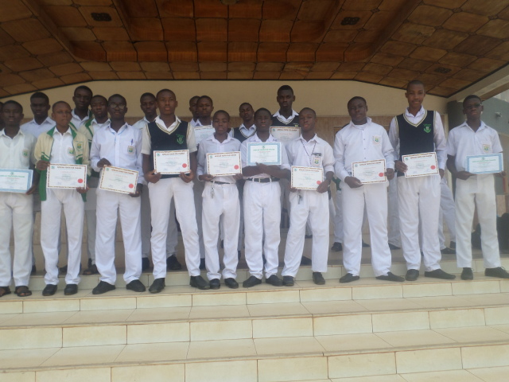
AFRICAN YOUTH FOR CHANGE INITIATIVE
Michael Twene Osei| Ashesi University | twene.osei@ashesi.edu.gh
Mission
To create an exclusive platform for African youth to identify, develop as they utilize their talents and skills in a cooperative manner, to solve the challenges confronting the continent and our world.
Challenges
We have challenges obtaining funds to run our projects and leadership training. Combining schoolwork and the training can be tedious for our young leaders.
Impact
Our young leaders have the greater representation in student leadership.
We have successfully undertaken three civic engagement projects for young people.
Our young leaders have also benefitted from local and international opportunities including scholarships.
Project Description
.
The AYCI is a youth-led and youth-focused organization that nurtures young people to be initiators and catalysts of transformative change on the continent and beyond. The AYCI does this by training young leaders through clubs with a curriculum that emphasizes on leadership, ethics, entrepreneurship and personal development. Our comprehensive curriculum also provide experiential learning for recruits to practice what they learn from the training.
Our Partners
National Youth Authority, Ghana.
Notes:
1

